Slide 1
CFSe for Special School Settings and Colleges

Slide 2
Why train on communication?
Children with disabilities and their parents argue communication should be considered as a fundamental desired outcome ( In It together: achieving quality outcomes for young people with complex needs)
'Communication with people with the most complex needs is most successful with familiar, responsive partners’ ('Communication and people with the most complex needs: What works and why this is essential (July 2010) J Goldbart, S Caton

Slide 3
Why train on communication?
'Before 6, children with ASD make the most changes in their language development. To have the biggest impact on a child’s language, we need to start before they reach 6.' Pickles, A., Anderson, D. K., & Lord, C. (2014).
'Almost anyone diagnosed with an autism spectrum disorder will benefit from working on their communication skills' Verywell health 2018
Children and families affected by autism need teachers and helping professionals who 'get it'. Families First 2018

Slide 4
Elklan Communication Friendly Settings (CFSe) Award
Accreditation for schools who have trained and supported their staff in communication and language development
Consists of three steps
Usually completed over an academic year

Slide 5
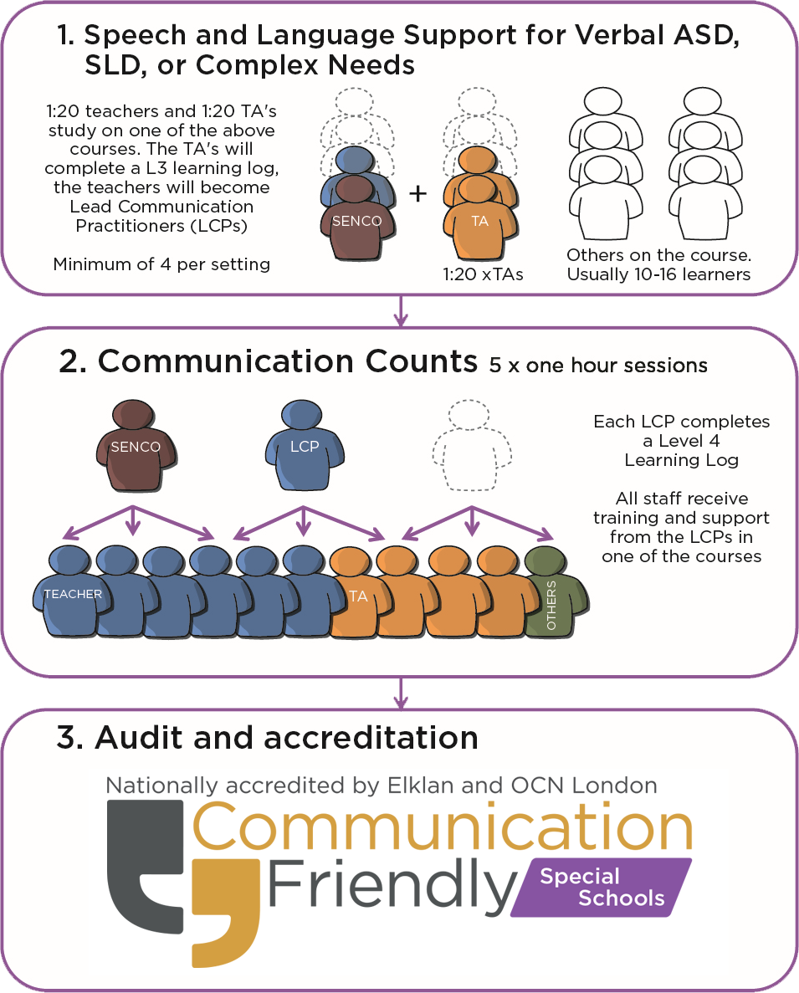
CFSe special schools model

Slide 6
What is the Level 3 award?
The Level 3 award is an is an externally verified and accredited award through OCN London
It is achieved by attending an Elklan course and completion of a Level 3 Learning Log
The Learning Log consists of tasks that learners complete with children and young people in their settings to put into practice what they have learnt from the course.

Slide 7
Structure of the programme
1:20 staff in the school need to have completed either ‘Speech and Language Support for Pupils with SLD’, ‘Communication Support for 0-25s with Complex Needs’ or ‘Verbal Pupils with ASD’ course. The TA’s complete a Level 3 Learning Log
The Level 4 qualification does not involve attending another course
Level 4 LCPS cascade a 5 x 1 hour session course (Communication Counts) to all staff in their school
They are mentored by an Elklan tutor throughout the delivery of Communication Counts to the staff team.

Slide 8
Communication Counts – Level 4
Schools can choose which of the Elklan courses they wish to cascade to the whole school staff
A combination of courses can be cascaded to meet the nature of the school
Whichever course(s) are chosen there MUST be 1:20 teachers trained at step 1. Where there are less than 20 staff there must be a minimum of 2 teachers trained.

Slide 9
Communication Counts – Level 4
The course completed at Step 1 must match the cascade to be delivered
All staff in the school, teaching and non-teaching will complete one or other of the cascaded courses to achieve CFSe status
Over the next three years all courses can be cascaded again to different staff as the school requires.

Slide 10
Additional information
Settings who have staff trained in the past three years in the relevant Elklan course at Level 3 can be counted in the numbers
Staff who trained more than three years ago will complete a skills and knowledge questionnaire to determine if additional training is required

Slide 11
Recent changes!
Teachers completing CFSe award no longer need to complete the Level 3 Award.
They will be asked to complete a set of knowledge quizzes before starting the CFSe Cascade.
Information about e-opportunities can be found at: https://www.elklan.co.uk/information/practitioners/e-learning-opportunities

Slide 12
What is the time commitment for LCPs?
5 x 1-hour staff training sessions to the whole staff team
4 x seminars with the Elkan tutor lasting approx. 1-2 hours depending on the number of settings involved
Approximately 15 hours to write up the Level 4 Learning Log.

Slide 13
CFSe - Benefits
Level 4 trained staff (Lead Communication Practitioners) train and support all staff to understand and improve the communication skills of pupils.
All staff gain significantly improved knowledge and confidence in SLCN.
Pupils make statistically significant progress in receptive and expressive language.
Employers state that communication skills are a high priority for the employability of school leavers, especially in the sections of industry requiring technical and manual skills.
The Setting retains the capacity to renew and refresh training for its staff in the future.

Slide 14
CFSe - Benefits
Quality First Teaching is accelerated by enhanced question differentiation, interaction techniques and vocabulary planning which are taught on the CFSe programme
Unwanted behaviour is strongly linked to poor communication skills which, in turn, are often identified in pupils of lower ability. Training in SLCN encourages early and effective management of behaviour by all staff and may reduce costly disciplinary procedures
Parents can be informed by trained staff to understand their children’s communication difficulties and how the school is responding to these
Speech and Language Therapy provision is greatly enhanced by collaboration between professionals and Elklan trained staff.

Slide 15
How much does it cost?
It depends on whether you already employ an Elklan tutor who can take you through the training or if you buy the tutoring from Elklan directly
Prices will vary depending on individual school profiles. To request a quote please use our online CFSe enquiry form at https://www.elklan.co.uk/contact
If you are unsure about courses, numbers of staff to train or want to check details, please use the enquiry form and either Clare, Katie or Liz will get in touch.

Slide 16
Renewals
CFSe is valid for 3 years
A renewals policy is available on the CFSe tracker
This is light touch but robust
Elklan can provide a tutor to take schools through the process.

Slide 17
What do I do now?
Talk to your local Elklan tutor if you have one
Email Elklan to request a tutor to take you through the process or complete an online enquiry form

Slide 18
Any questions?
Please submit a CFSe enquiry form via our website at www.elklan.co.uk
If you still have queries then email Clare, Katie or Liz:
clare@elklan.co.uk
katie@elklan.co.uk
liz@elklan.co.uk

